Slide 1



SUDOKU SOLVER AND GENERATOR
PROJECT MEMBERS
MEGAPRANITHAA M 23ITR096
MOUNITH D 23ITR103
KARTHIKEYAN R 23ITR081
JAIHARI D (19ITR028)
PROJECT GUIDE
MS.S.KAVITHRA
(Assistant Professor)
Department of IT
Kongu Engineering College

Slide 2

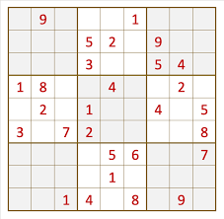
To develop a Python application that can both generate and solve Sudoku puzzles.
The application should provide users with a user-friendly interface to generate a valid Sudoku puzzle with varying difficulty levels (e.g., easy, medium, hard).
Users should also be able to input a custom Sudoku puzzle, which the application can then solve using an efficient algorithm.
Additionally, provide an option for users to save the generated or solved Sudoku puzzle as an image or a text file for later use.

Slide 3
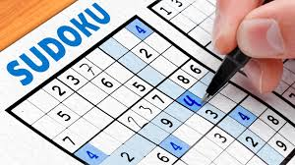
Objectives
Validation of Sudoku Puzzles: Include functionality to validate the correctness of the Sudoku puzzles, ensuring they adhere to the standard rules and have a valid solution.
Performance Optimization: Optimize the solver and generator for efficiency, allowing the handling of puzzles of different sizes and difficulties in a reasonable time frame.
Save and Load Puzzles: Implement features to save Sudoku puzzles and solutions to a file, as well as load puzzles from a file for solving or further editing.
3

Slide 4
Software Tools used
Python: The primary programming language for developing the Sudoku solver and generator application.
VSCODE
Libraries:
NumPy: For handling arrays and matrices, which are crucial for representing the Sudoku grid and performing various operations on it.
random: For generating random numbers, which is essential for creating new Sudoku puzzles with varying difficulty levels.
backtracking algorithm (implemented in Python): For solving the Sudoku puzzle by trying out possible numbers and backtracking when a conflict is encountered.
Tkinter: For creating a graphical user interface (GUI) to interact with the Sudoku solver and generator.
PIL (Python Imaging Library) or Pillow: For handling images if the Sudoku puzzles are generated or displayed as images.
Pygame: For adding more advanced graphical features or animations to the Sudoku solver and generator.
4

Slide 5
IMPLEMENTATION DETAILS
USER
INTERFACE
GRID REPRESENTATION
SUDOKU GENERATOR
SAVING
SUDOKU SOLVER
TESTING AND DEBUGGING

Slide 6
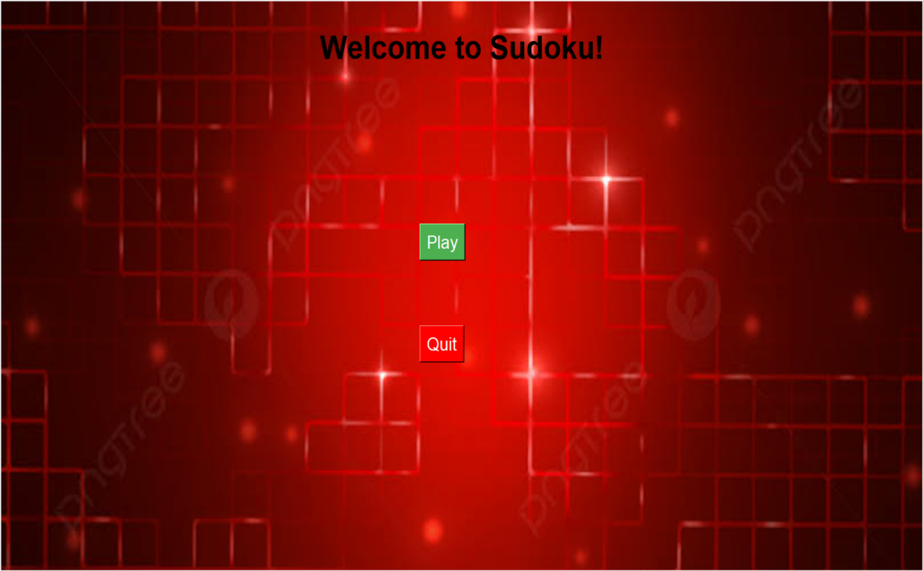
MODULES
STEP 1:

Slide 7
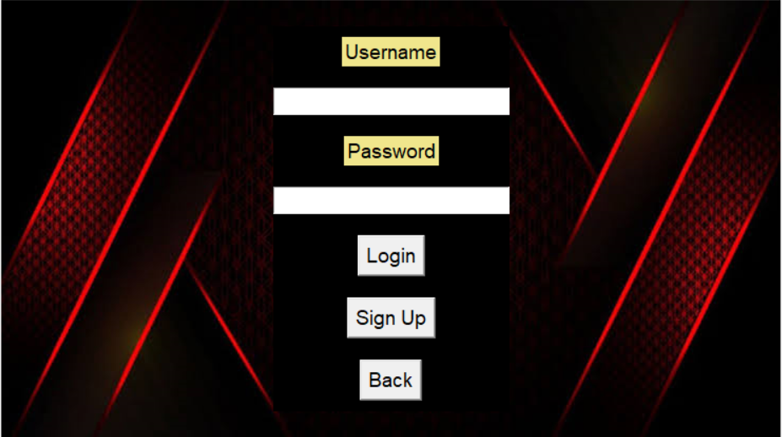
MODULES
STEP 2:

Slide 8
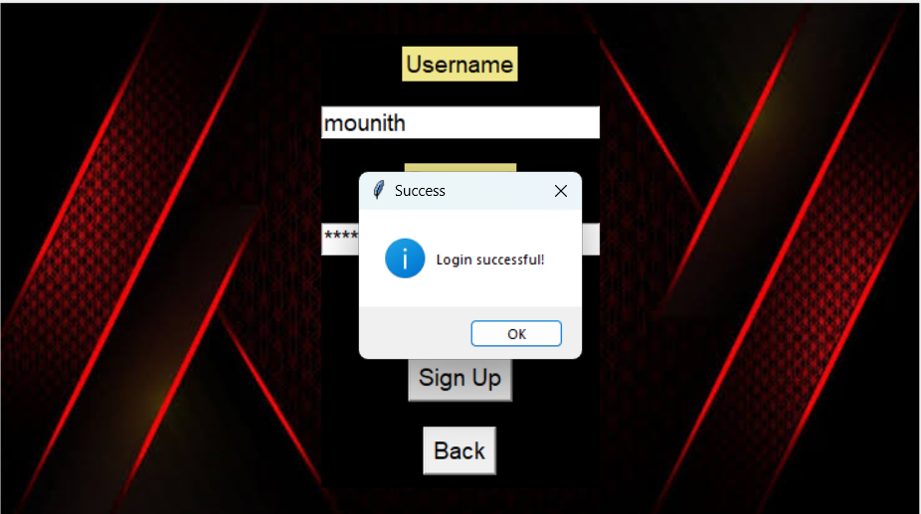
MODULES
STEP 3:

Slide 9
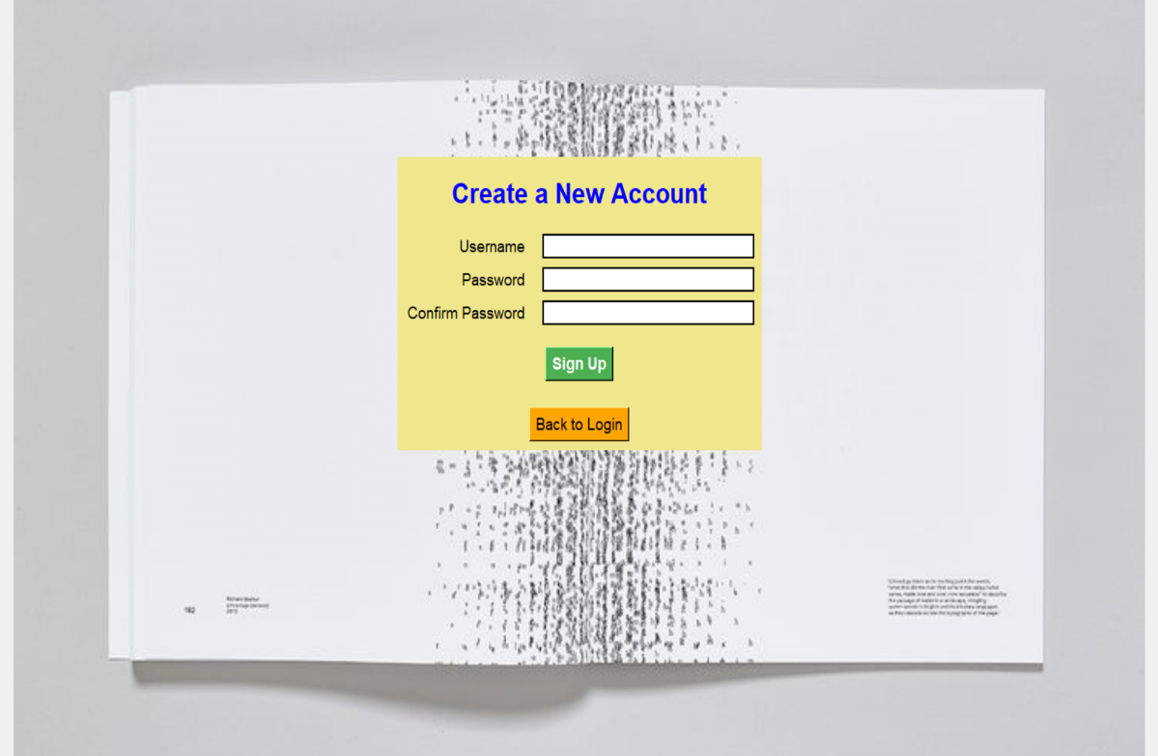
MODULES
STEP 4:

Slide 10
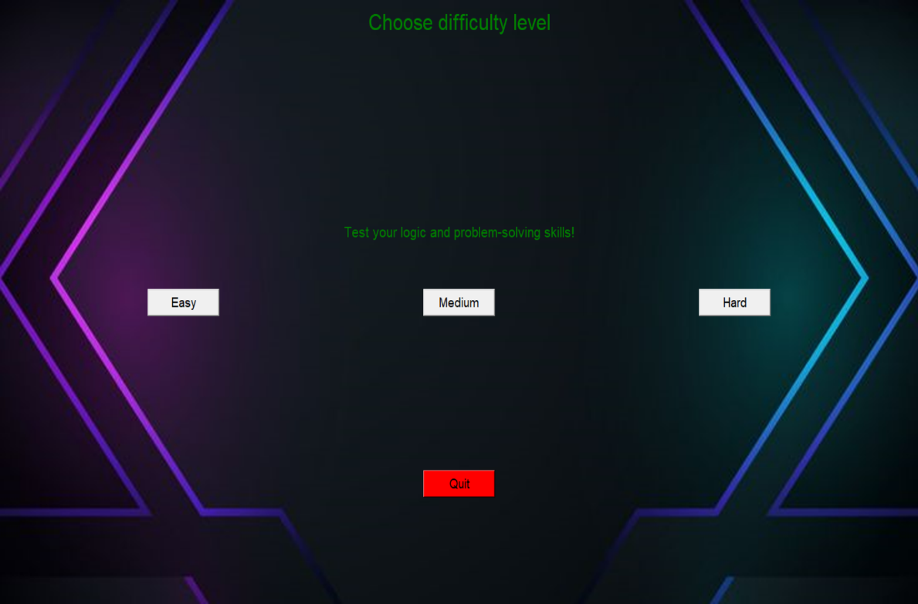
MODULES
Step 5:

Slide 11
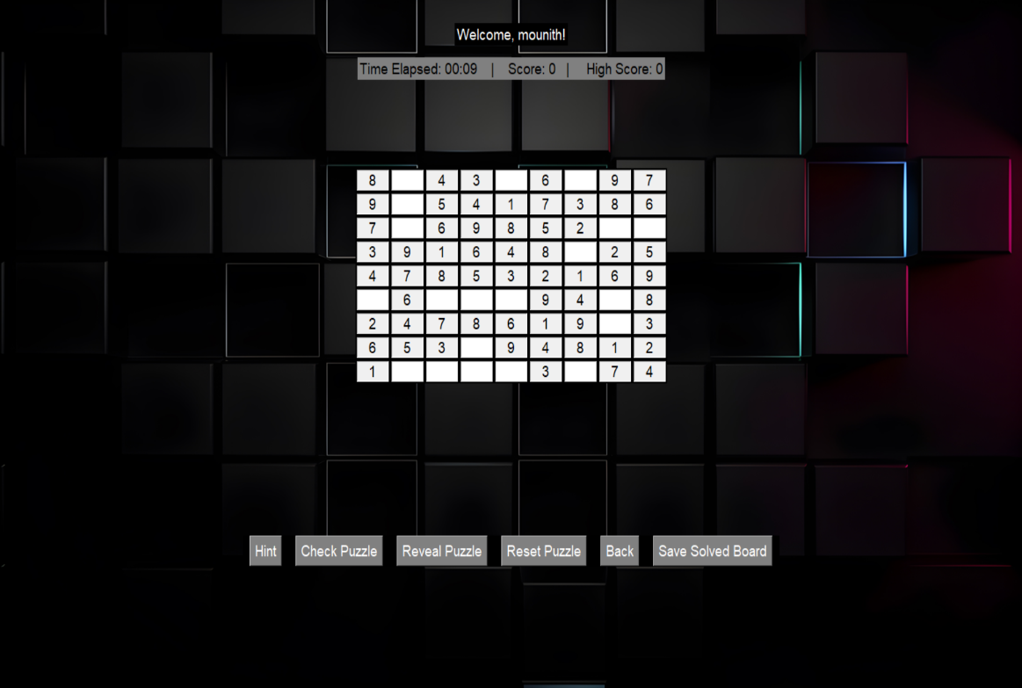
MODULES
Step 6:

Slide 12
REFERENCES
Peter Norvig,Director of Research at Google,Reference: Sudoku Solver using Constraint Propagation and Search -[Peter Norvig's Sudoku Guide](https://norvig.com/sudoku.html)
Dan Bader,Software Developer, Author, and Founder of Real Python,Reference:Sudoku Solver and Generator in Python- [Real Python Guide](https://realpython.com/python-sudoku-solver/)
Jose Portilla ,Head of Data Science at Pierian Data ,Reference: Creating and Solving Sudoku Puzzles in Python- [Towards DataScience](https://towardsdatascience.com/creating-and-solving-sudoku-puzzles-in-python-3e9d6aae4811)
GeeksforGeeks Team ,Technical Content Team, GeeksforGeeks ,Reference: Sudoku Solver in Python using Backtracking - [GeeksforGeeks](https://www.geeksforgeeks.org/sudoku-backtracking-7/)
Siemen,Data Scientist, Python Enthusiast,Reference:How to Solve a Sudoku with Python (Backtracking Algorithm) - [Medium](https://medium.com/@siemen/python-backtracking-solving-sudoku-82f1d850d5a)

Slide 13
Thank you!

